Slide 1
HSC Library Administration
SciVerse Scopus
Guide

Slide 2
SciVerse Scopus
About SciVerse Scopus:
SciVerse Scopus is the world’s largest abstract and citation database of peer-
reviewed literature and quality web sources with smart tools to track, analyze
and visualize research. It's designed to find the information scientists need.
SciVerse Scopus is the easiest way to get to relevant content fast. Tools to sort,
refine and quickly identify results help you focus on the outcome of your work.
You can spend less time mastering databases and more time on research.
Quick, easy and comprehensive, SciVerse Scopus provides superior support of
the literature research process.

Slide 3
SciVerse Scopus
• Contains 41 million records, 70% with abstracts.
• Nearly 18,000 titles from 5,000 publishers worldwide.
• 70% of content is pulled from international sources.
• Includes over 3 million conference papers.
• Provides 100% Medline coverage.
• Offers sophisticated tools to track, analyze and visualize research.

Slide 4
This guide will show you how to:
1. Use Document search
2. Use Author search
3. Use Affiliation search
4. Use Advanced search
5. Browse Sources
6. Use Analytics
7. Personalize My Alerts
8. Personalize My List
9. Personalize My Settings

Slide 5
Document search

Slide 6
Performing a Document search
The document search form is designed to guide us in creating a useful search.
For example:
We want to search for documents with main subjects relating to “ Heart Attack ”
and “ Migraine ” in “ Women “ published within the last five years.

Slide 7
From the Document search form
1. Enter the search terms “ Heart Attack “ AND “ Migraine” in the Search for box.
2. Select the field (Article Title, Abstract, Keywords) from the drop-down menu.

Slide 8
3. To add a search field, click on the add search field link.
4. Select the Boolean operator (AND).
Boolean operators are used to narrow the scope of your search:
AND: Results will match the query from both text boxes.
OR : Results will match the query from either of the text boxes.
AND NOT: Results will match the query in the first text box but not the second.
5. Enter the search term “Women” then select the required fields (Article Title, Abstract, Keywords).

Slide 9
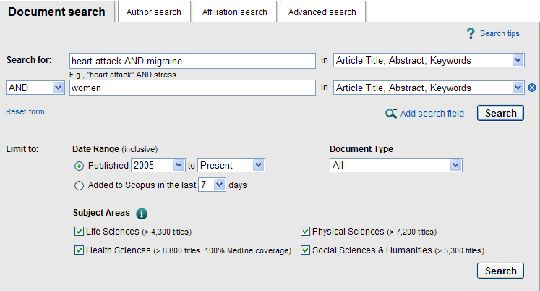
6. To retrieve articles published within the last five years, we need to set the limit by date range.
7. In the Limit to section, Select 2005 to Present.
8. In the document type, select “All”.
9. Click on the Search button.

Slide 10
10. Document results will be displayed.

Slide 11
Author search

Slide 12
Performing an Author search
The Author Search is designed to find all variations of an author name that are online as well as documents written by a specific affiliation.
For example:
We want to review the writings of Prof. Nabila Abdella affiliated to Kuwait University.

Slide 13
From the Author search form
1. Enter the author name information in the appropriate fields.
Last Name: Abdella – Initials or First Name: Nabila
Affiliation: Kuwait University – This will limit your search to this affiliation.
2. Check the Show exact matches only box.
This will limit our search to this author’s exact name.
3. Click on the Search button.

Slide 14
Prof. Nabila Abdella’s name will be displayed with the (62) documents written by this author, the subject area and affiliation.
4. To view the documents, Select the author name by ticking on the checkbox and click on Show Documents.
5. all (62) Document results will be displayed.

Slide 15
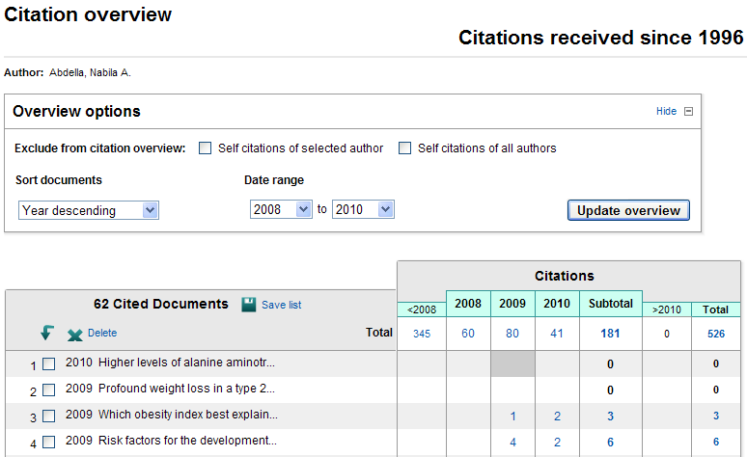
6. To view the citation overview of the author, tick the checkbox next to Prof. Nabila Abdella’s name then Click on View citation overview .
7. The Citation overview for Prof. Nabila will be displayed.

Slide 16
8. To view a specific document citation of a specific year, for example, we want to look at the citation overview for the document (Risk Factors for the development….).
9. Select the document title by ticking the checkbox.
10. Click on the number (4) listed under the Year (2009) column to view the citation overview of this document.
11. This shows that the selected document was cited (4) times in (2009).

Slide 17
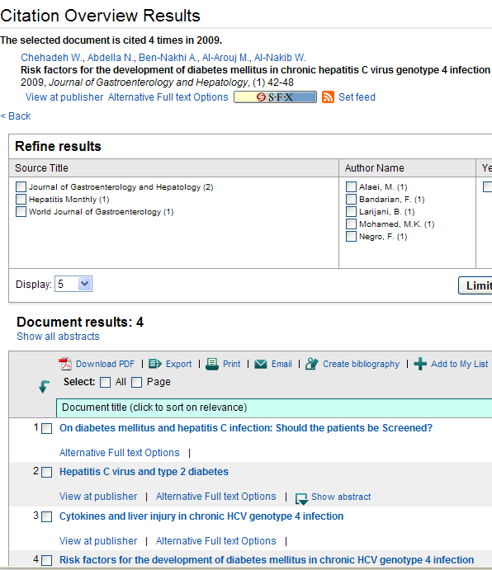
12. Citation overview results will be displayed.

Slide 18
Affiliation search

Slide 19
Performing an Affiliation search
Affiliation Identifier is the world's first tool to help you identify and group an organization's complete body of work. It turns a time-consuming process into a simple task.
For Example:
We want to search for documents affiliated to Harvard University.

Slide 20
From the Affiliation search form
1. Enter the affiliation Harvard University in the Affiliation box.
2. Click on the Search button.
3. Affiliation results will be displayed.

Slide 21
4. To retrieve the documents of an affiliation, tick the checkbox next to the affiliation name. (You can choose more than one affiliation).
5. Click on Show Documents.
6. Document results will be displayed.

Slide 22
Advanced search

Slide 23
Performing an Advanced search
Advanced Search is designed to create a search using field codes, Proximity operators or Boolean operators to narrow the scope of the search.
Scopus uses the following two proximity operators:
1. PRE/n "precedes by". Where the first term in the search must precede the second by a specified number of terms (n).
2. W/n "within". Where the terms in the search must be within a specified number of terms (n). Either word may appear first.
Example:
1. pain W/15 morphine finds articles in which "pain" and "morphine" are no more than 15 terms apart.
2. behavioural PRE/3 disturbances finds articles in which "behavioural" precedes "disturbances" by three or fewer words.

Slide 24
How to perform an Advanced search
For example:
We want to search for documents containing the term “Heart Attack” written by the author “Smith” that was published in “1993”.

Slide 25
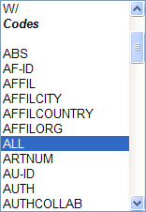
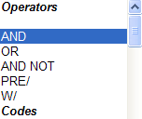
From the advanced search form
1. From the codes list, select (ALL) by double clicking on it, this option
will search all fields.
2. Type “Heart Attack” in the brackets.
3. From the list of operators, select the operator (AND) by double clicking on it.
4. Select (AUTH) from the codes then type “Smith” in the brackets.
5. Select (AND) then (PUBYEAR) from the list of codes and type (IS 1993), the option (IS) will retrieve documents published in 1993 only.

Slide 26
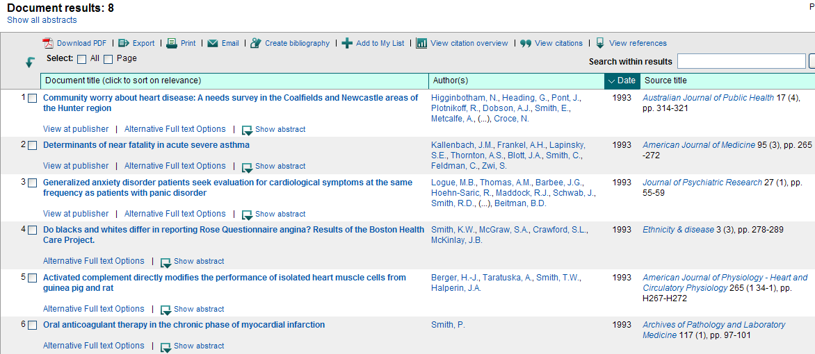
6. Click on the Search button.
7. Search results will be displayed.

Slide 27
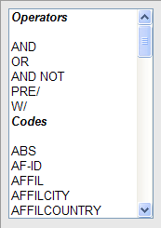
Field codes
You can search for a term in a specific field by entering the field code in your Advanced search.
The following slides will further explain the meanings of codes and operators used to conduct an advanced search in Scopus.

Slide 28
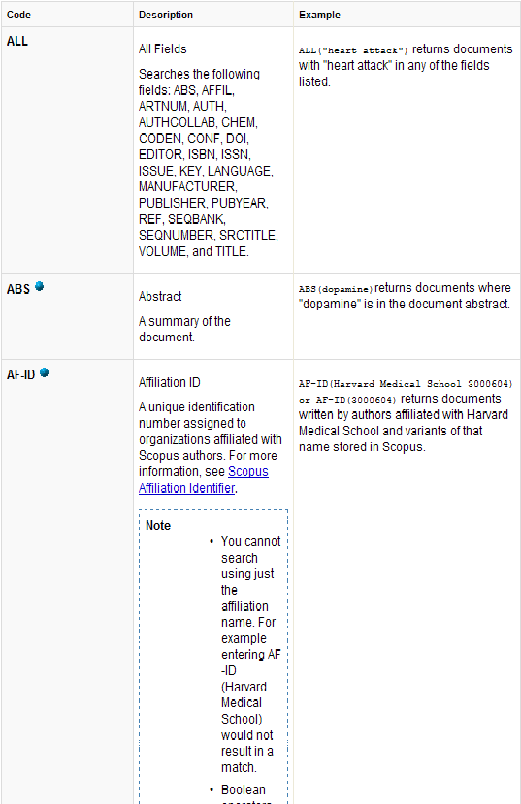
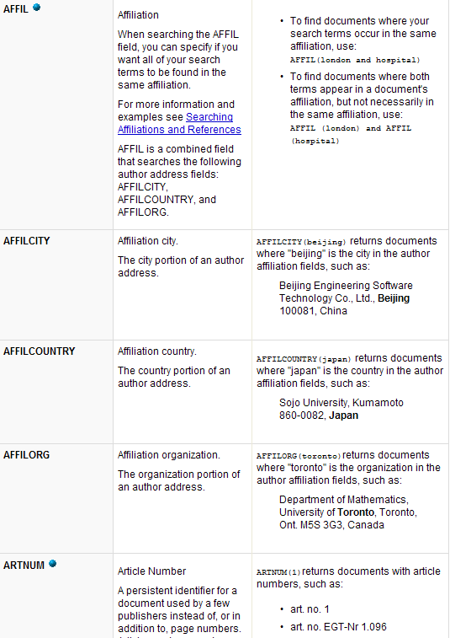

Slide 29
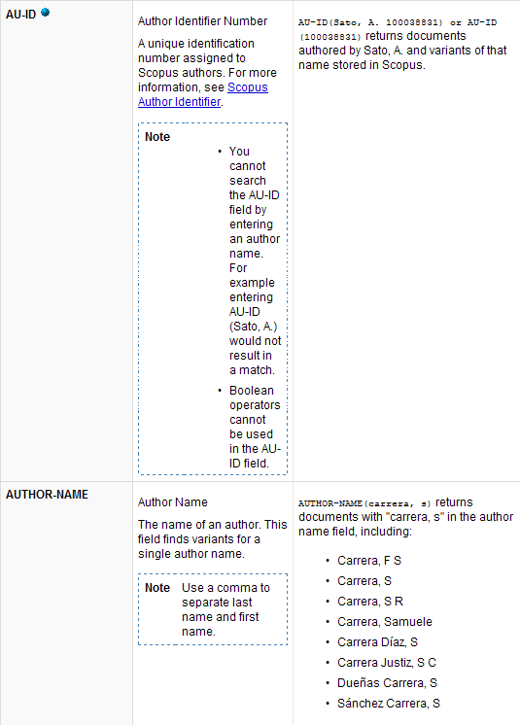
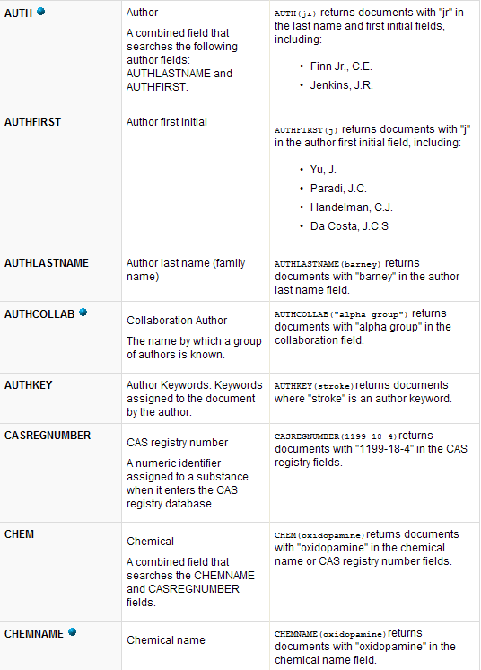

Slide 30
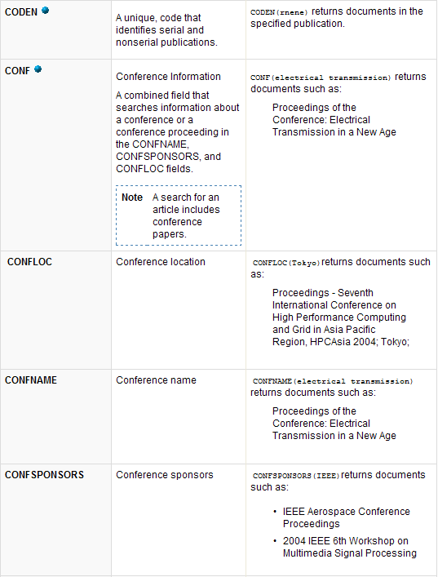
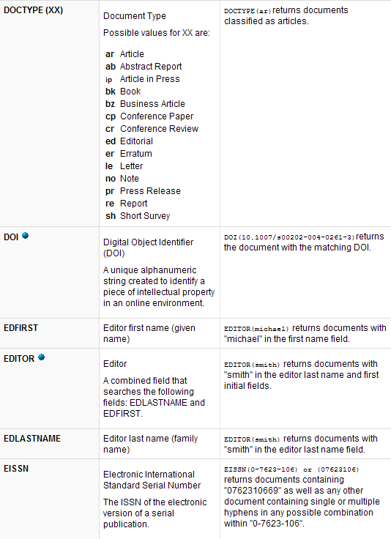

Slide 31
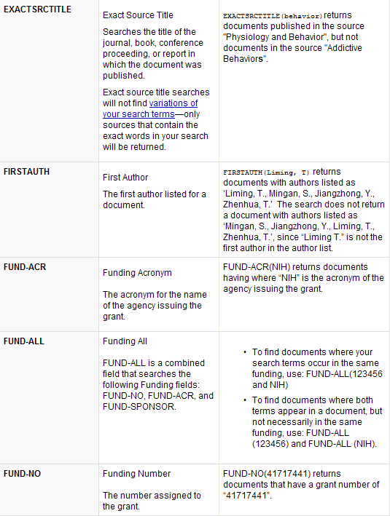
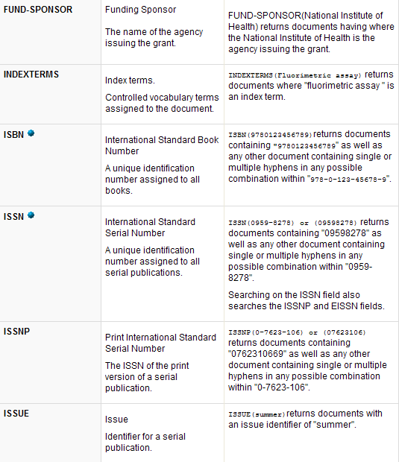

Slide 32
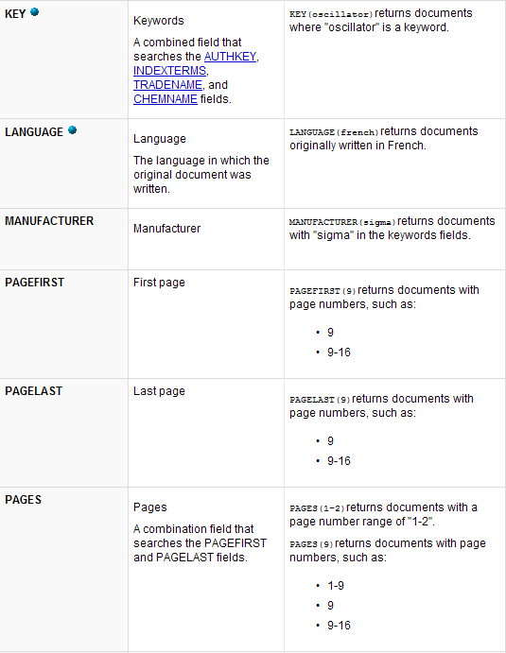
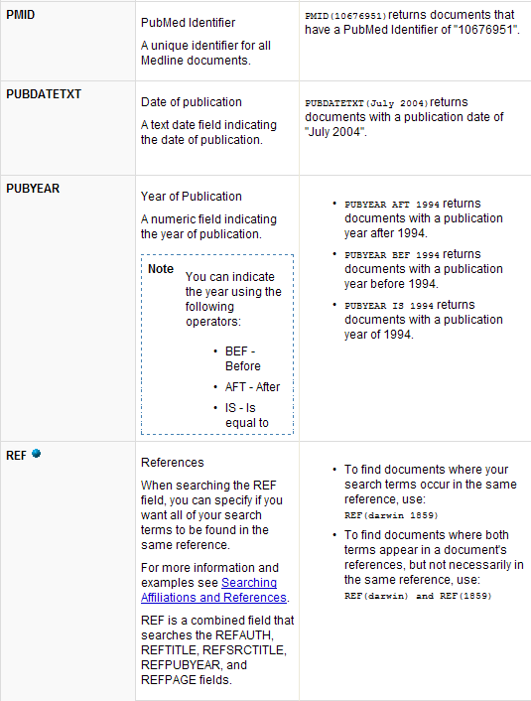

Slide 33
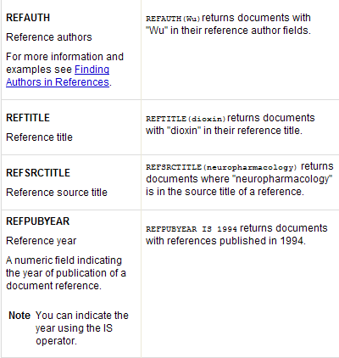
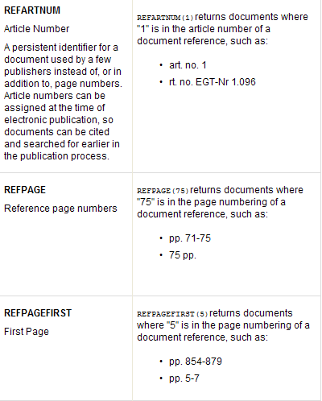

Slide 34
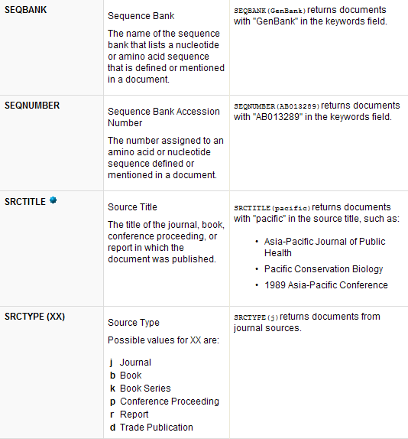
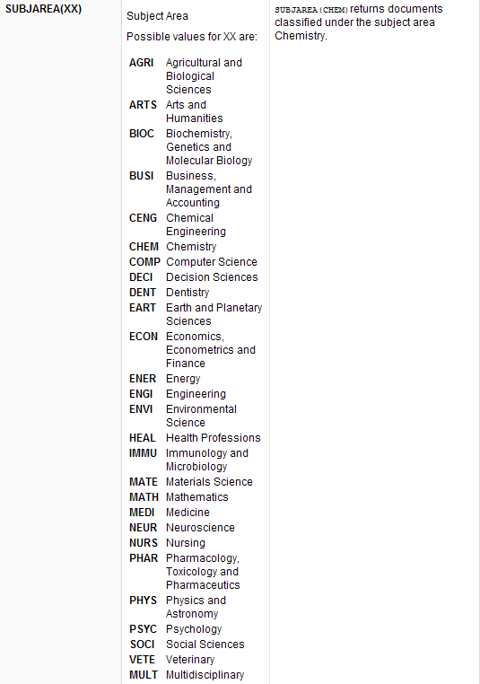

Slide 35
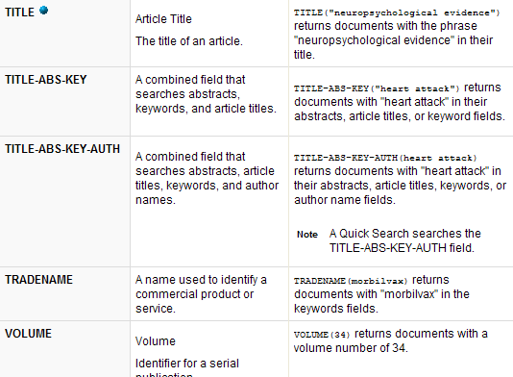

Slide 36
Browse Sources

Slide 37
Browsing Sources
The Sources tab allows you to browse an alphabetical list of all journals, book series, trade publications and conference proceedings available in Scopus or on external platforms.
From the navigation bar:
1. Click on Sources.

Slide 38
2. You can browse all source titles alphabetically by selecting the first letter of the Journal title.
3. You can browse the source titles sorted by subject.
For Example:
We want to search for a list of Journals in the subject area Chemistry.
1. From the Subject Area, select “Chemistry” from the drop down menu.
2. From the Source Type, Select “Journals” from the drop down menu, this will limit your search results.
3. Click on the Display sources button.

Slide 39
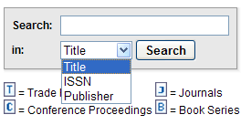
4. A total of (12) Search results will be displayed.
5. You can search for a source by Title, ISSN or Publisher by using the side Search form.

Slide 40
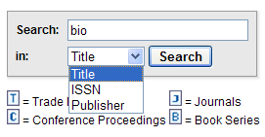
For Example:
We want to search for all source titles containing the search term “ Bio”.
From the side Search form:
1. Type the term “bio” in the Search box.
2. Select “ Title” from the In drop down menu.
3. Click on the Search button.

Slide 41
4. Search results matching the term “bio” will be displayed.
5. Journal metrics columns ( SJR – SNIP ) show the current metric values for the sources.
6. Click on the source title to view the publication’s information page.

Slide 42
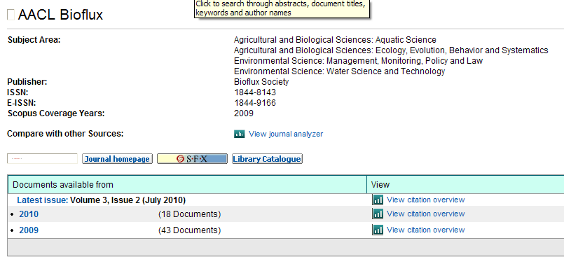
7. The publication details of the source title are displayed at the top of the source information page.
8. To generate a Citation overview for a specific year of the publication , click on View citation overview for example, let’s click on the Citation Overview of 2010.

Slide 43
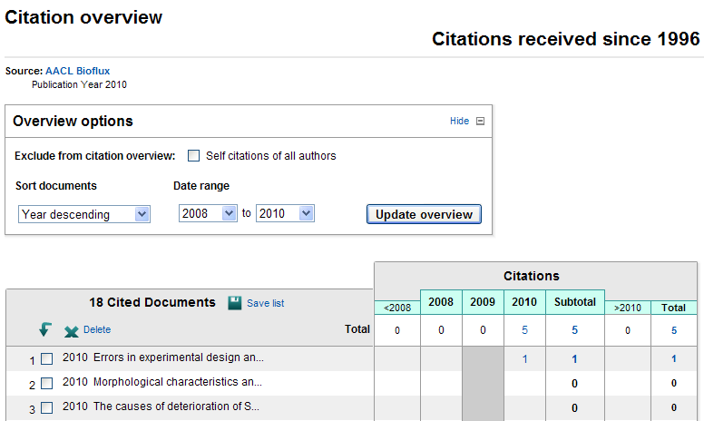
9. An overview of the citations of documents of the year 2010 will be displayed.
10. The selected document ( Errors in experimental design …) is cited (1) time in 2010.
11. To view the Citation, Click on number (1) from the citations.

Slide 44
12. The article that cited the document ( Errors in experimental
design …) will be displayed.
13. To view the article, Click on the title.

Slide 45
Analytics

Slide 46
Analyzing Journals
The Journal Analyzer is used to compare up to 10 Scopus sources on a variety of parameters: SJR, SNIP, citations, documents and the percentage of documents not cited.
The analyzer is available in both a Line Chart and a Table view. The Line Chart displays information in a line graph, with separate graphs for each parameter. The Table lists parameters together in one table.
For Example:
We want to analyze the Journal “ Pediatric Infectious Diseases Journal” in terms of SJR which is a measure of the scientific prestige of scholarly sources.

Slide 47
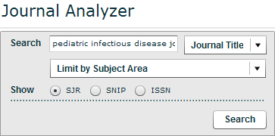
From the navigation bar:
1. Click on Analytics.
2. Enter the Journal title “Pediatric Infectious disease journal” in the Search box.
3. Select SJR then click on the Search button.

Slide 48
4. Journal results will be displayed.
5. To add the Journal to the chart or table for analyzing, double click on the title and drag it to the right.
6. To switch between the Chart and Table views, Click on the preferred option.

Slide 49
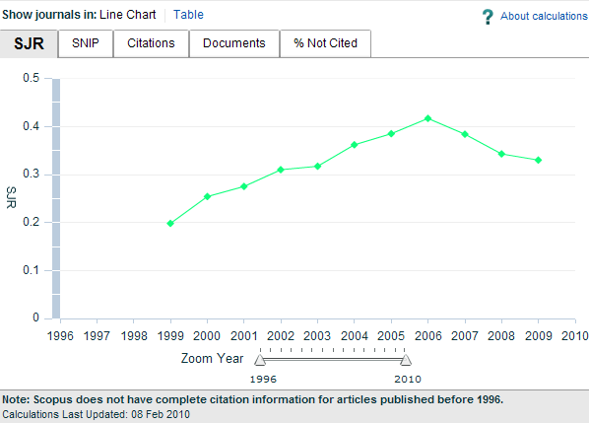
6. This is the chart form of the journal analyzer for “Pediatric Infectious Disease Journal”.
7. To view the analyses ( SJR – SNIP – Citation – Documents - % Not Cited ), Click on the preferred tab on the chart.

Slide 50
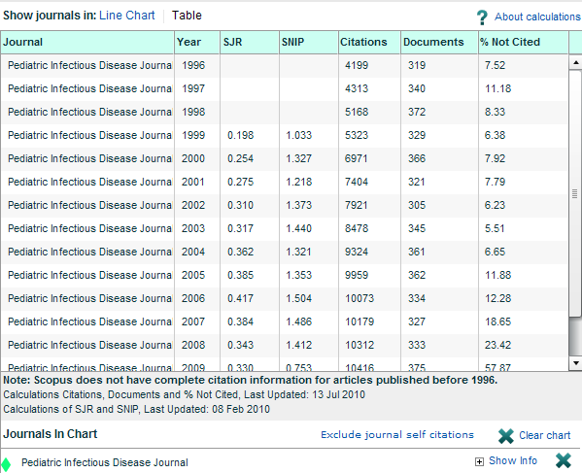
8. This is the Table form of the Journal Analyzer.
9. The analyses ( SJR – SNIP – Citation – Documents - % Not Cited ) are listed in the table.

Slide 51
My Alerts

Slide 52
About My Alerts
You must be logged into Scopus in order to take advantage of the My Alerts feature.
If you have not logged into Scopus, you will not be able to access My Alerts, My List and My Settings Pages.

Slide 53
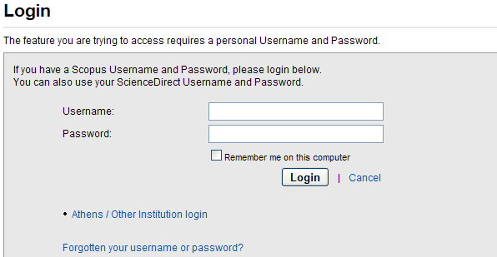
From the navigation bar:
1. Click on My Alerts.
2. A Login page to Scopus will be displayed.
3. Enter your Scopus username and
password in the appropriate fields.
• Your username and password are
both case-sensitive.

Slide 54
4. My Alerts page will be displayed.

Slide 55
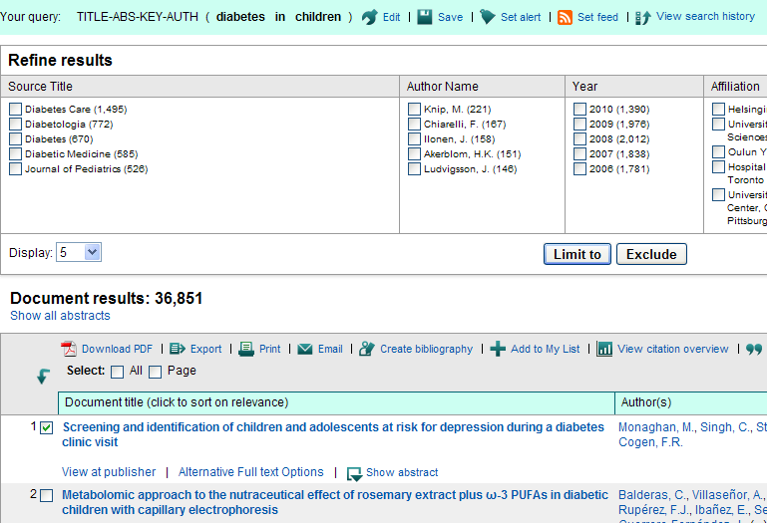
For Example:
We want to set an Alert for an article relating to “diabetes in children”.
From the Search form:
1. Enter “ Diabetes in children” in the Search box.
2. Click on the Search button.
3. Set the Alert on any article by ticking the checkbox next to the article you want to set an alert for.
4. Click on Set alert.

Slide 56
5. Fill the appropriate fields & preferences.
6. Click on the Create button.

Slide 57
My List

Slide 58
About My List
The My List page shows the temporary list of documents you created during a Scopus session. You can work with this list in the same way as you work with any search results list - output the list, track citations, refine the list and so on.
For Example:
We want to add an article relating to “placental abruption” to My List.

Slide 59
From the Search form
1. Enter “ Placental Abruption” in the Search box.
2. Click on the Search button.
3. Select the articles you want to add to your list by ticking the checkboxes.
4. Click on Add to My List.

Slide 60
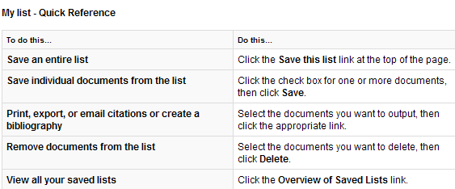
My List - Quick Reference

Slide 61
My Settings

Slide 62
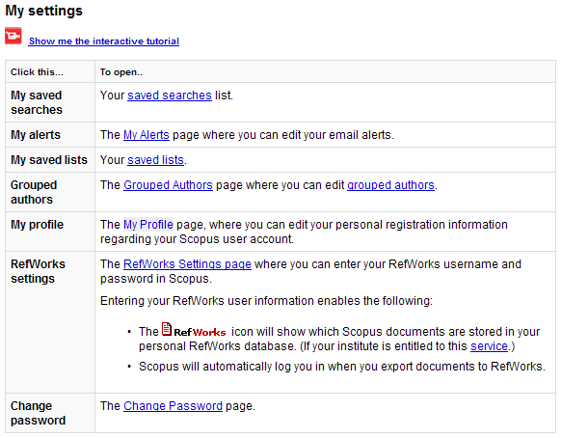
About My Settings
• You may do the following from the My Settings Page:

Slide 63
Thank You for viewing
the Scopus Guide
HSC Library Administration
Training Department

